Slide 1
K-Map:-Karnaugh Map
The K-map is a systematic way of simplifying Boolean expressions.
A K-map contains all the possible values of input variables and their corresponding output values.
However, in K-map, the values are stored in cells of the array. In each cell, a binary value of each input variable is stored.
With the help of the K-map method, we can find the simplest SOP and POS expression, which is known as the minimum expression.
Sum of Product (SOP) or (AND-OR implementation)
As the name suggests, it is formed by adding (OR operation) the product terms. SOP is sum of minterms and represented by Σ.
Product of Sums (POS) or (OR-AND implementation)
POS-As the name suggests, it is formed by multiplying (AND operation) the sum terms. POS is product of maxterms and represented by Π.

Slide 2
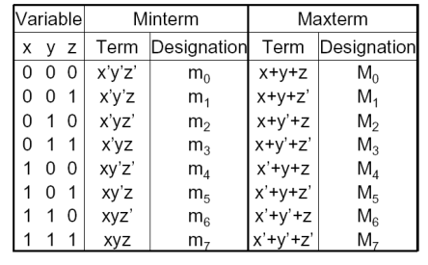
Min-term and Max-term Table

Slide 3
Select a K-map according to the total number of variables;
Identify maxterms or minterms as given in the problem;
For SOP, put the 1’s in the blocks of the K-map with respect to the minterms
For POS, put 0’s in the blocks of the K-map with respect to the maxterms
Make rectangular groups that contain the total terms in the power of two such as 2,4,8 ..(except 1) and try to cover as many numbers of elements as you can in a single group;

Slide 4
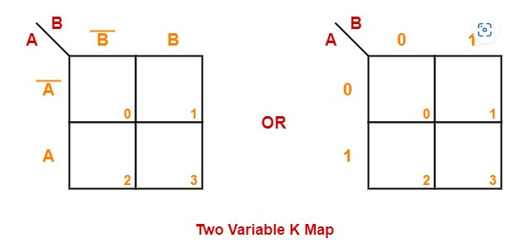
Two Variable K-Map

Slide 5
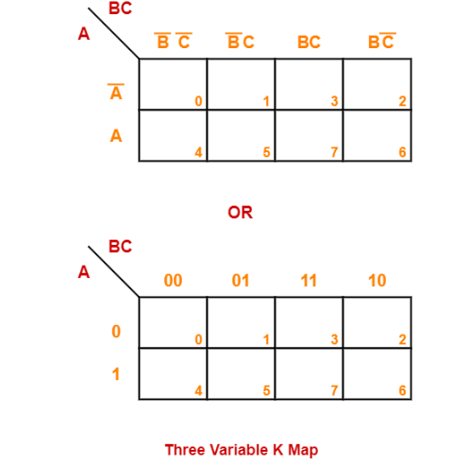
Three Variable K-Map

Slide 6
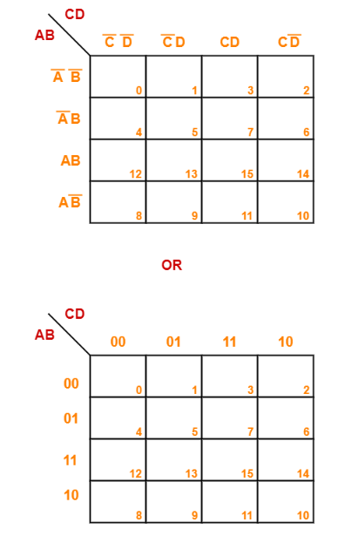
Four Variable K-Map

Slide 7
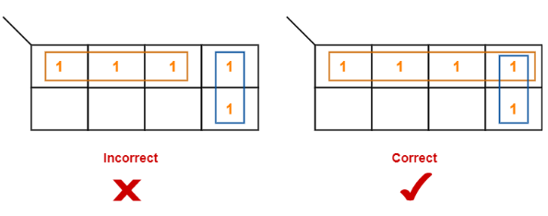
K-Map Simplification Rules-
We can either group 0’s with 0’s or 1’s with 1’s but we can not group 0’s and 1’s together.
Groups may overlap each other.
We can only create a group whose number of cells can be represented in the power of 2.
In other words, a group can only contain 2^{n} i.e. 1, 2, 4, 8, 16 and so on number of cells.

Slide 8
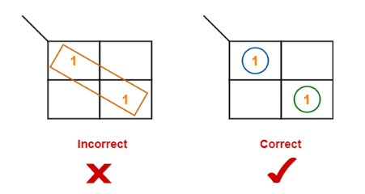
Groups can be only either horizontal or vertical.
We can not create groups of diagonal or any other shape.

Slide 9
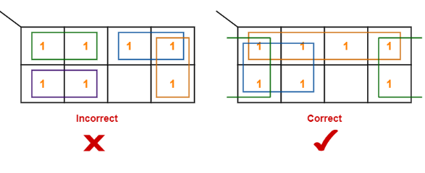
Each group should be as large as possible.

Slide 10
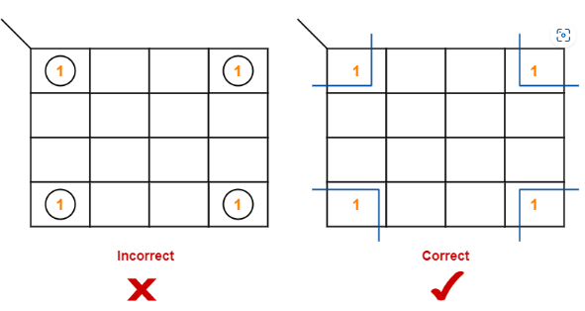
Opposite grouping and corner grouping are allowed.

Slide 11
Questions
Minimize the following boolean function- F(A, B, C, D) = Σm(0, 1, 2, 5, 7, 8, 9, 10, 13, 15)
Minimize the following boolean function-F(A, B, C, D) = Σm(0, 1, 2, 5, 7, 8, 9, 10, 13, 15)
Minimize the following boolean function-F(A,B,C)=π(0,3,6,7)
Minimize the following boolean function-F(A,B,C,D)=π(3,5,7,8,10,11,12,13)
Minimize the following boolean function-F(A, B, C) = Σm(1, 3, 6, 7)

Slide 12
Minimize the following boolean function-F(A, B, C, D) = Σm(3, 4, 5, 7, 9, 13, 14, 15) A’BC’ + A’CD + AC’D + ABC
Consider the following boolean function- F(W, X, Y, Z) = Σm(1, 3, 4, 6, 9, 11, 12, 14) XZ’ + X’Z
Minimize the following boolean function- F(A, B, C) = Σm(0, 1, 6, 7) + Σd(3, 5) AB + A’B’
Minimize the following boolean function-F(A, B, C) = Σm(1, 2, 5, 7) + Σd(0, 4, 6) A + B’ + C’
Minimize the following boolean function-F(A, B, C, D) = Σm(0, 2, 8, 10, 14) + Σd(5, 15) ACD’ + B’D’

Slide 13
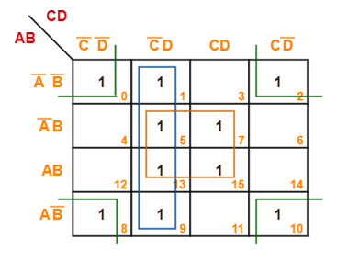
Solutions
BD + C’D + B’D’

Slide 14
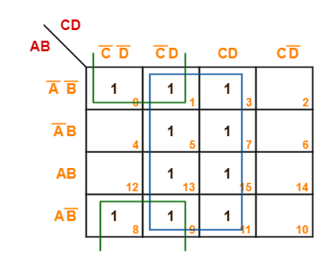
D + B’C’

Slide 15
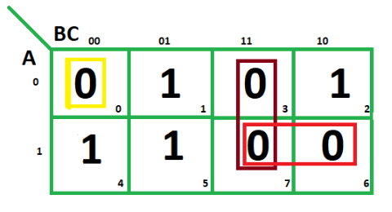
(A' + B’) (B’ + C’) (A + B + C)

Slide 16
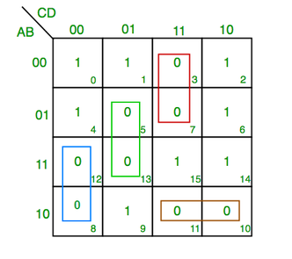
(C+D’+B’).(C’+D’+A).(A’+C+D).(A’+B+C’)

